Slide 1
Enhanced Entity Relationship

Slide 2
ER vs. EER
When we move to an Enhanced Entity Relationship (EER), threre are additional concepts:
Superclass and subclass
Inheritance
Specialization and generalization
Disjointness - Disjoint vs. Overlapping constraints
Completeness - Total vs. Partial specialization

Slide 3
Superclass and Subclass
A superclass is a general entity type that contains attributes and relationships common to several more specific entity types. A subclass is a specialized entity type that inherits characteristics from the superclass and may have additional attributes or relationships of its own.
Example: Employee -> Novice, Experienced, Very Experienced
A subclass does not need to have attributes of its own. It inherits the attributes and relationships of its superclass and may exist simply to represent different constraints, relationships, or classifications.
A Superclass needs to have at least one attribute.

Slide 4
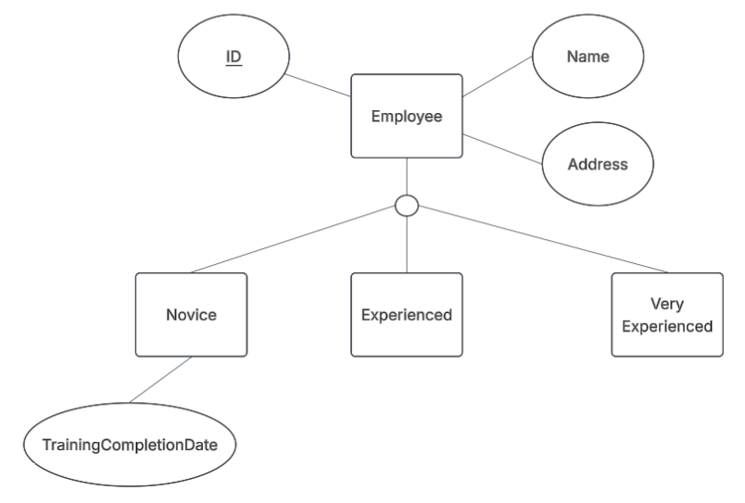

Slide 5
Inheritance
Inheritance means that a subclass automatically receives the key attributes, other attributes, and relationships of its superclass. The subclass can also have its own unique attributes.
Example: Full-Time Employee inherits EmployeeID, Name, and HireDate from Employee.

Slide 6
Specialization and Generalization
Specialization is a top-down process that divides a superclass into more specific subclasses based on distinguishing characteristics.
Generalization is a bottom-up process that combines similar entity types into a more general superclass.
Example: Employee → Novice + Experienced + Very Experienced is specialization;
Vehicle -> Car + Truck
Novice + Experienced + Very Experienced -> Vehicle is a generalization
Car + Truck → Vehicle is generalization.

Slide 7
Completeness — Total vs. Partial Specialization
The completeness constraint determines whether every entity in the superclass must belong to a subclass.
Total specialization: Every superclass entity must belong to at least one subclass. Specified by two lines.
Partial specialization: A superclass entity may exist without belonging to any subclass. Specified by a single line.
Example: If every Employee must be either Novice, Experienced or Very Experienced, the specialization is Total.

Slide 8
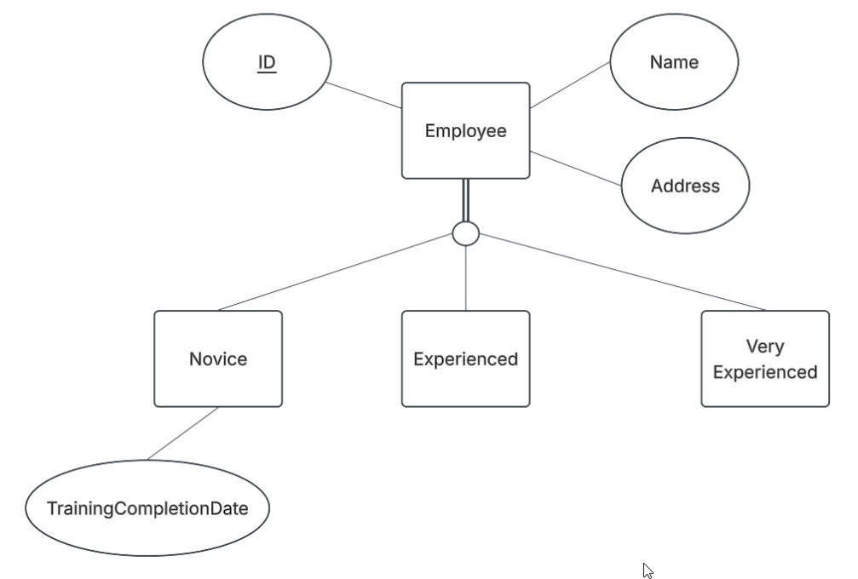
Total Specialization

Slide 9
Disjointness — Disjoint vs. Overlapping Constraints
The disjointness constraint determines whether a superclass entity may belong to more than one subclass.
Disjoint: An entity can belong to only one subclass. Specified by the letter ‘D’.
Example: An Employee cannot be both Full-Time and Part-Time = Disjoint.
Overlapping: An entity can belong to more than one subclass at the same time. Specified by the letter ‘O’.
An University Personnel can be both Faculty and Staff. = Overlapping.

Slide 10
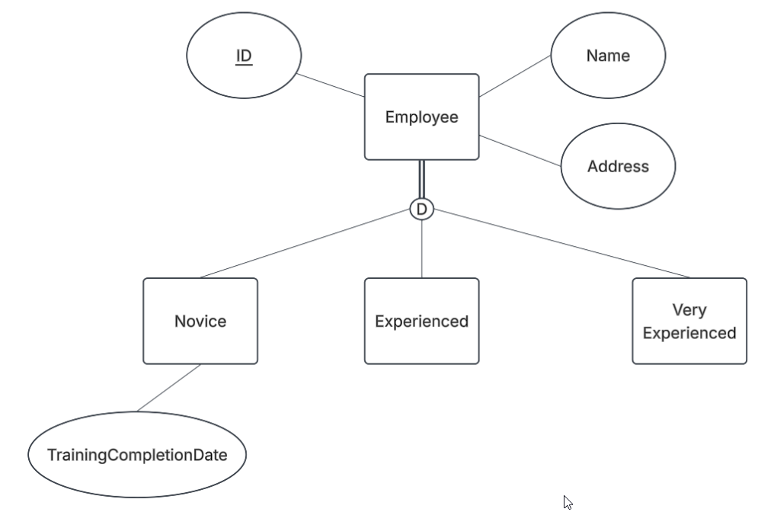
Disjoint and Total

